Slide 1

WebSpector:
JavaScript Execution Monitor
20160655 | Minyeop Choi
20150078 | Gyeongwon Kim
20150349 | Jihee Park
Advisor | Sooel Son

Slide 2
Problem statement
There are no services that detect websites which collect sensitive information

Slide 3


Others are guessing, not detecting!
Service A: Web of Trust
User review based
Service B: tosdr.org
Terms of service based

Slide 4
Others are guessing, not detecting!
They DO NOT consider actual behaviors
Service A: Web of Trust
User review based
Service B: tosdr.org
Terms of service based

Slide 5



Design goals
Interactive service
Inspect based on
actual behaviors
Various environments

Slide 6
Design goals
Inspect any websites on users’ requests
Provide a seamless & convenient Web service
Interactive service

Slide 7
Design goals
Judge websites based on concrete evidences
Inspect the website’s data access log
Inspect based on
actual behaviors

Slide 8
Design goals
Suspicious attacker may behave differently
Easy to add a new environment
Various environments

Slide 9
Our solution
Visit website
Monitor JS execution
Provide interactive web service
Prepare execution environment

Slide 10
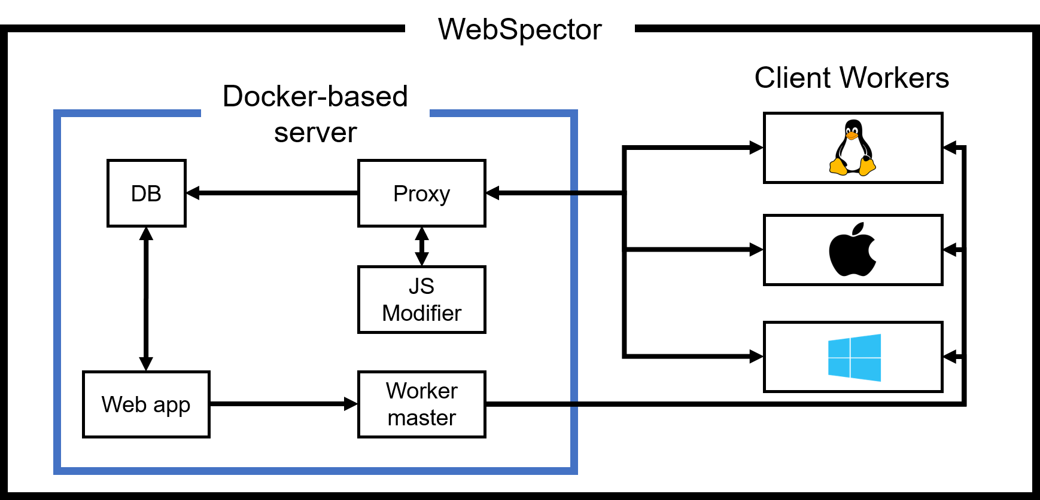
Detailed solution design

Slide 11








Client workers
Visit websites on possible OS & web browser combinations
WebSpector

Slide 12
Client workers
Visit websites on possible OS & web browser combinations
Provide realistic environments
No web browser emulation

Slide 13



Inspection
Inspect websites whether they collect sensitive data via JavaScript
WebSpector

Slide 14
Inspection
Inspect websites whether they collect sensitive data via JavaScript
Intercept the websites’ JavaScripts
Modify JavaScripts to have Proxy Object

Slide 15
Challenges
Challenge 1
Hard to control each browser process
Solution 1
Periodically restart the web browser

Slide 16
Challenges
Challenge 1
Hard to control each browser process
Solution 1
Periodically restart the web browser
Challenge 2
Hard to intercept communication on HTTPS
Solution 2
Add our self-signed certificate to the client workers

Slide 17


System statistics
5~10 sec. inspection
>10,000 website
inspection logs
Deployed on AWS

Slide 18
Evaluation
To check how accurate our system is
To compare similar services and ours

Slide 19
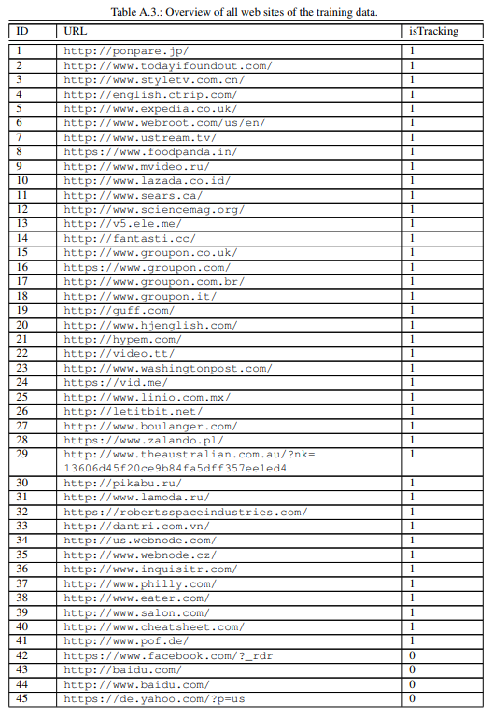
Evaluation
To check how accurate our system is
To compare similar services and ours
“On detecting Web-Tracking.” by Thomas Müller (2015)

Slide 20
Evaluation
Total 82 websites labeled whether they track users or not
7 out of 82 websites are not available
34 Tracking websites, 41 Not tracking websites

Slide 21
Evaluation

Slide 22
Evaluation
 | counts
True Positive | 24
False Positive | 10
False Negative | 5
True Negative | 36
WebSpector
Accuracy: 0.8
Precision: 0.706
Recall: 0.827

Slide 23
Evaluation
 | counts
True Positive | 24
False Positive | 10
False Negative | 5
True Negative | 36
 | counts
True Positive | 0
False Positive | 0
False Negative | 27
True Negative | 41
Unknown | 7
WebSpector
Web of Trust
Accuracy: 0.8
Precision: 0.706
Recall: 0.827
Accuracy: 0.547
Precision: 0
Recall: 0

Slide 24
Evaluation
 | counts
True Positive | 24
False Positive | 10
False Negative | 5
True Negative | 36
 | counts
True Positive | 0
False Positive | 0
False Negative | 27
True Negative | 41
Unknown | 7
>
WebSpector
Web of Trust
Accuracy: 0.8
Precision: 0.706
Recall: 0.827
Accuracy: 0.547
Precision: 0
Recall: 0

Slide 25
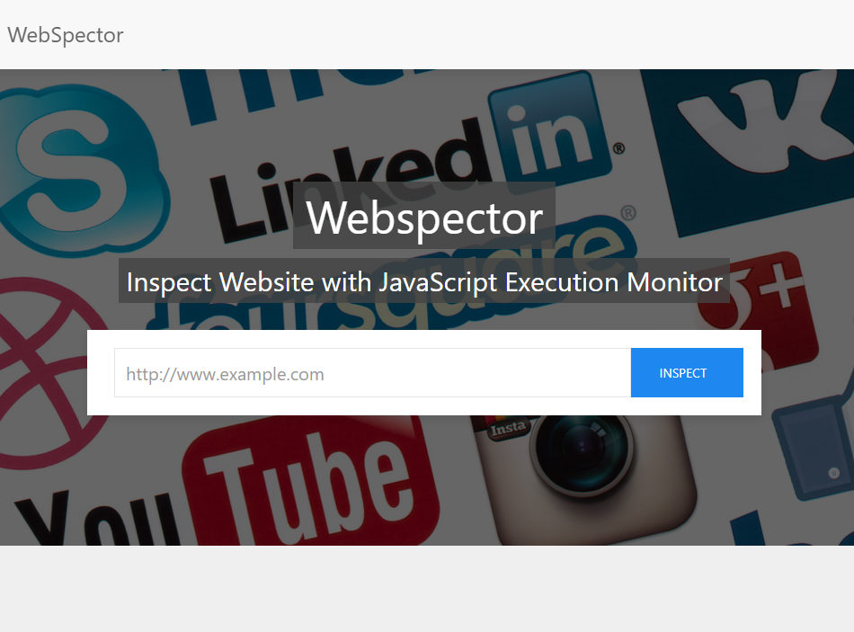

Slide 26
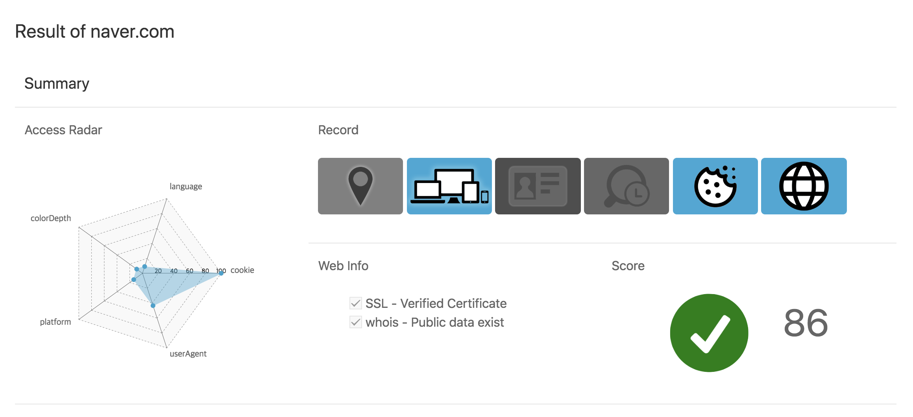

Slide 29
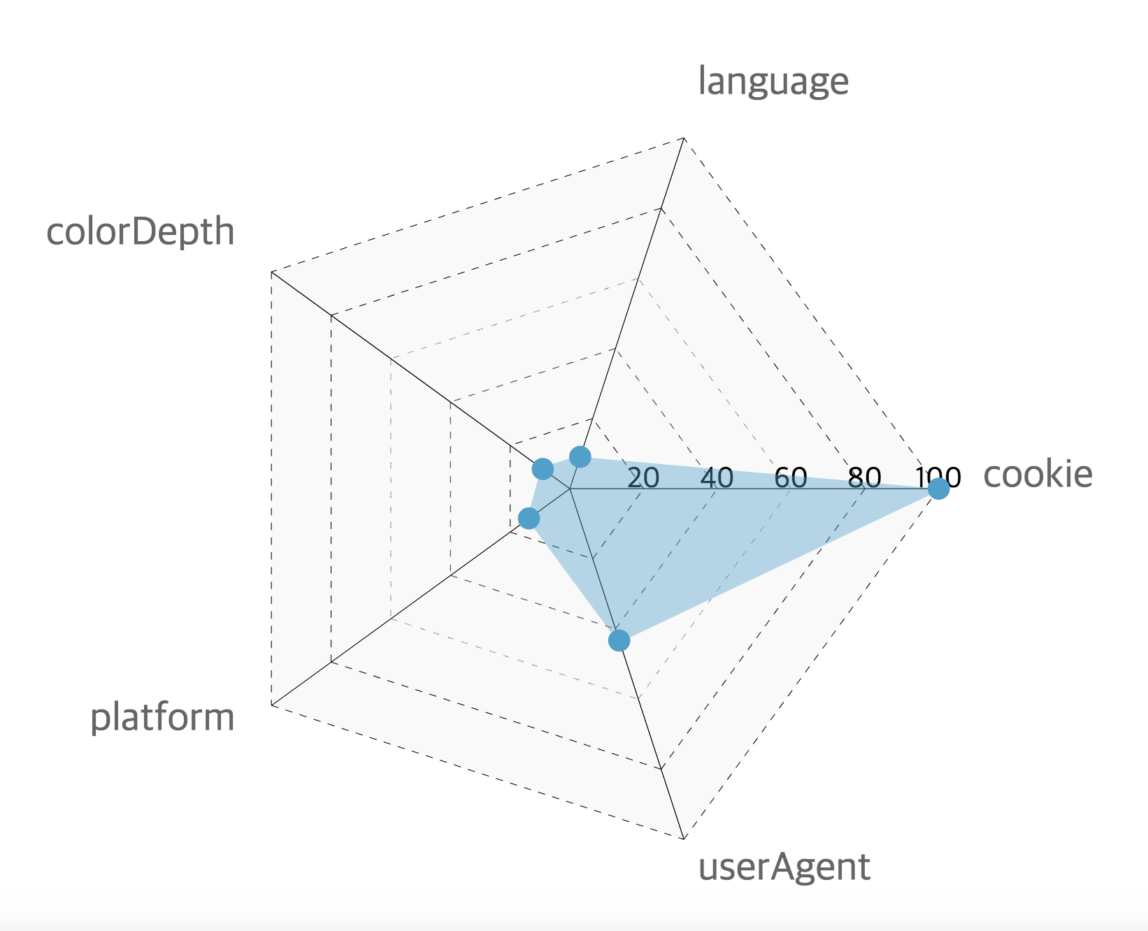

Slide 31


Slide 33
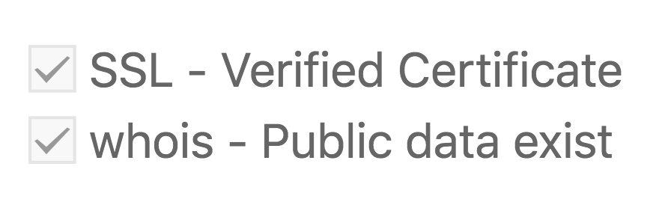

Slide 35


Slide 36
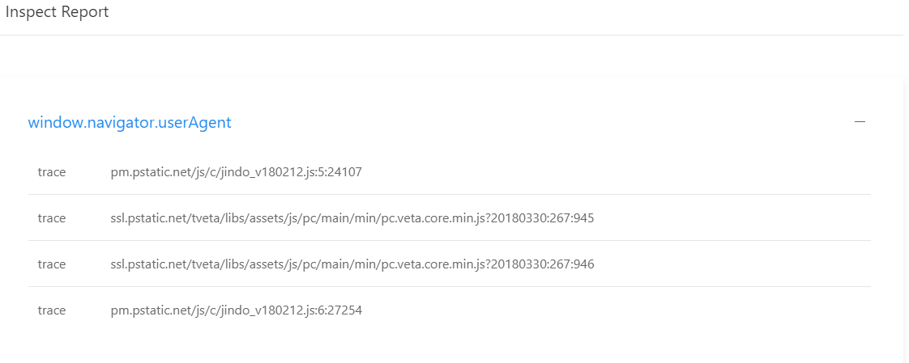

Slide 37
Demo
1. go to webspector.goatskin.kr:31313
2. Search a site which is known to track the user : http://cheatsheet.com
3. Watch result
(other example: ponpare.jp, groupon.com, ..)

Slide 38

Notes:
This is end of our presentation and thank you for listening. (…3 second) Is there any questions to ask?

